Slide 1
Predicting Siattle Collisions
Coursera Capstone Project

Slide 2
Predictiong collisions number is valuable for
Transportation Departments
Generally, drivers don’t think to the driving risks. Therefore, a public prevision system involved to forecast accidents may be a competitive and economic advantages to the community.
These measures, incidentally, present an urgent challenge – road accidents are one of the mainly cause of loss of human life in Europe.
Predicting the probability of risk collision could many sides.
  ○ Drivers advised by the on-board computer or smartphone to the safest route.
  ○ The police prepeared to monitor risky roads in advance.
  ○ The hospital administration prepeared for rescue faster and quicker.

Slide 3
Data acquisition and cleaning
Light conditions, road conditions, weather, location, type of junctions, location, day and time (2004-present) from Coursera dataset
In total, 194673 rows and 38 features in the raw dataset.
Null values from coordinates, some features with too much null values or features not strictly related were dropped.
Cleaned data contains 189339 rows and 9 features.

Slide 4
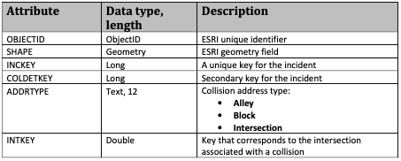
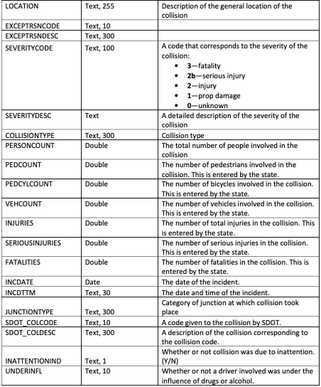
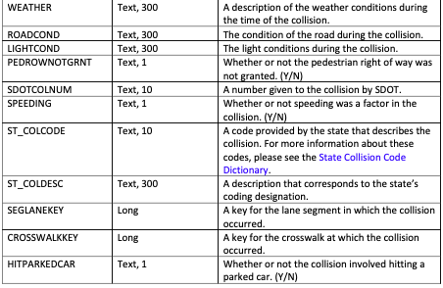
The original dataset metadata

Slide 5
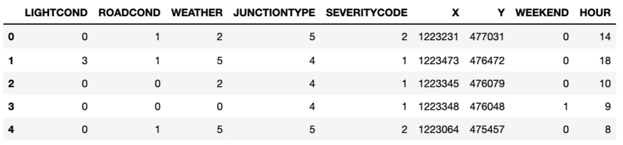
The dataframe final structure ready to analisys and fit models

Slide 6
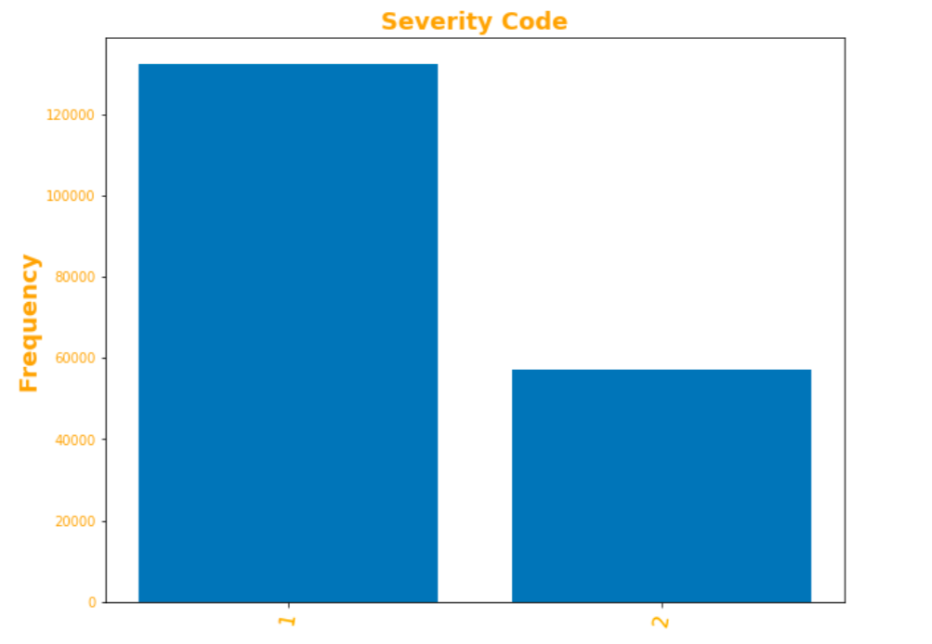
Most of the cases involved property damage, nearly half with injury

Slide 7
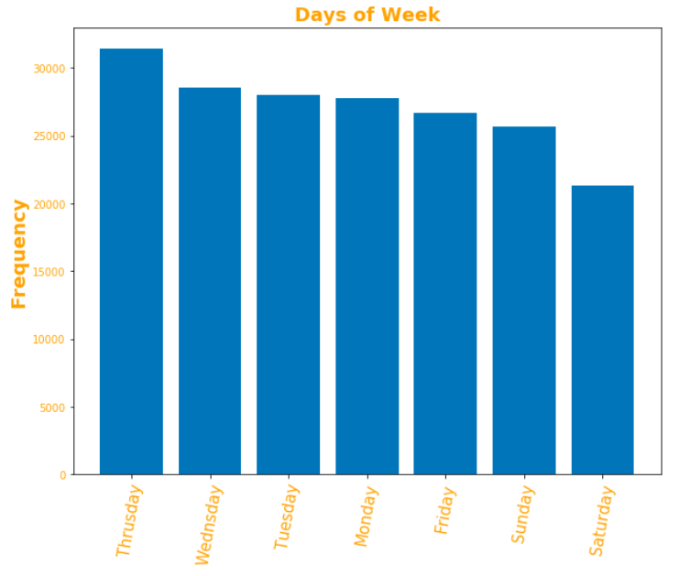
The highest category involves in the week days, and not in the weekends

Slide 8
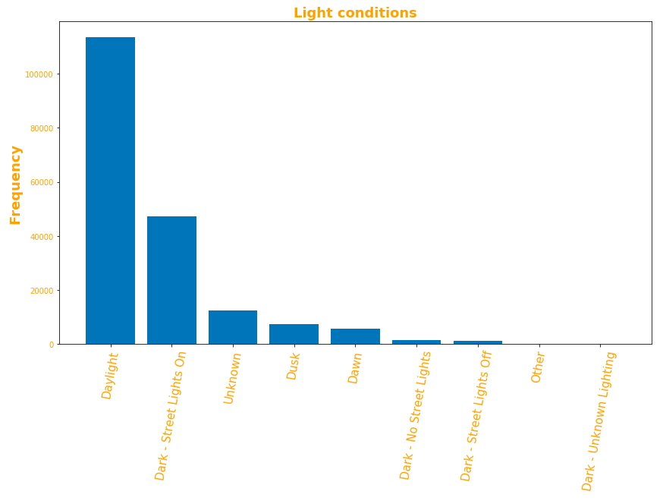
Mostly of accidents happen on the daylyght or when there are the street lights on, a much lower amount in other conditions

Slide 9
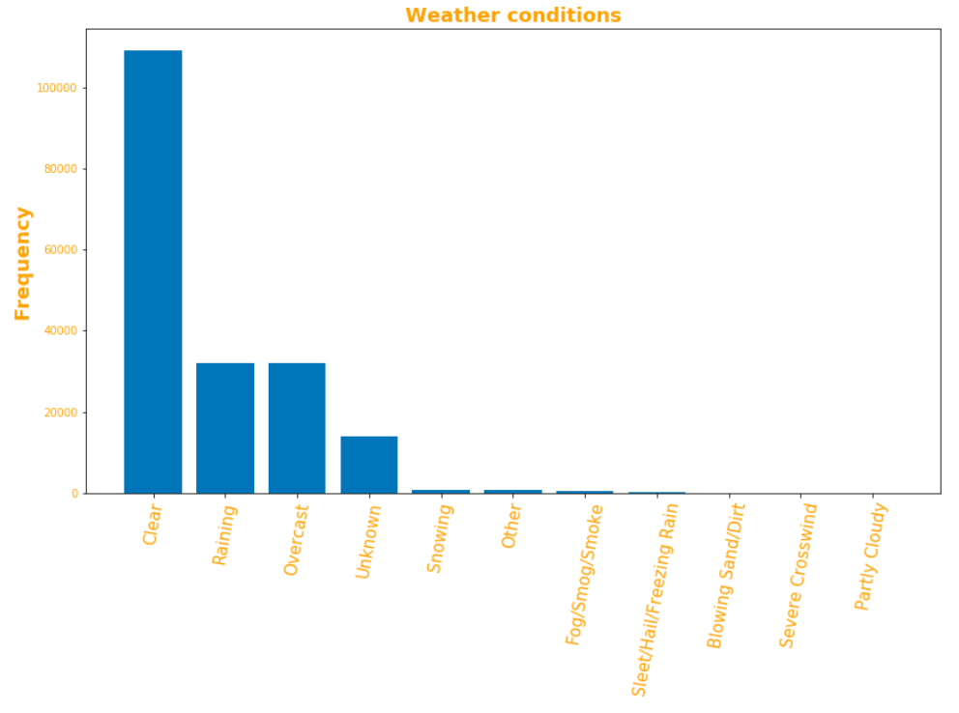
Most vehicle accidents occur during the best weather conditions during the day, raining and overcast are quite influencing, more
than other conditions

Slide 10
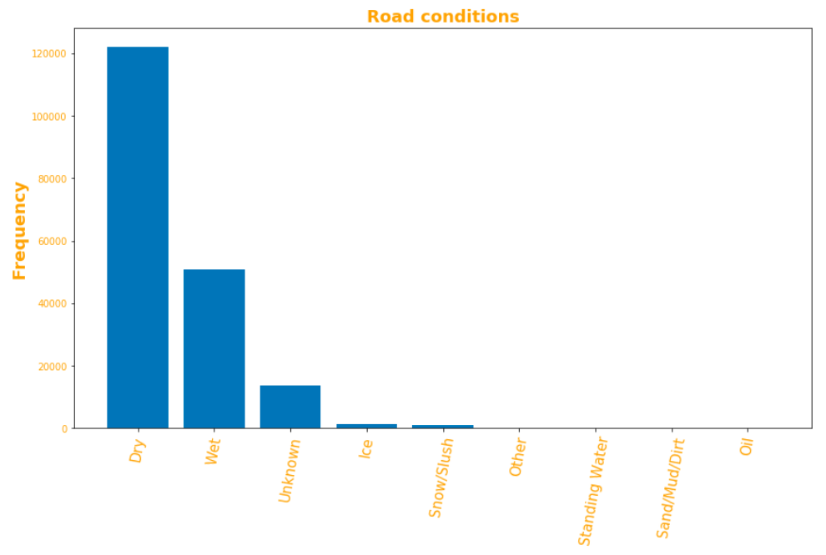
The road dry is the most frequent condition of collisions, the wet asphalt affect nearly half and much lower for other states
Here could be a bias of unbalacing, may be solved with more data and a standardizaion of number parameters

Slide 11
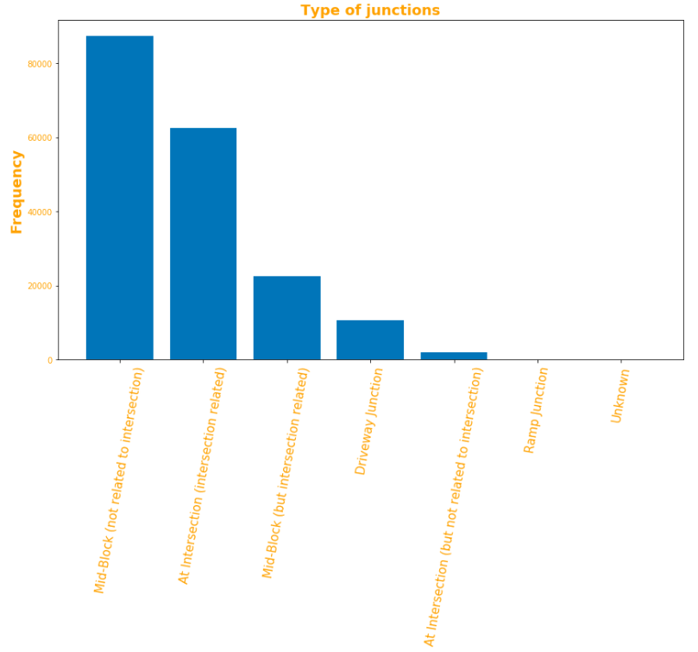
The block, or in a mid-block, or in the proximity of an intersection the risk is higher than elsewhere

Slide 12
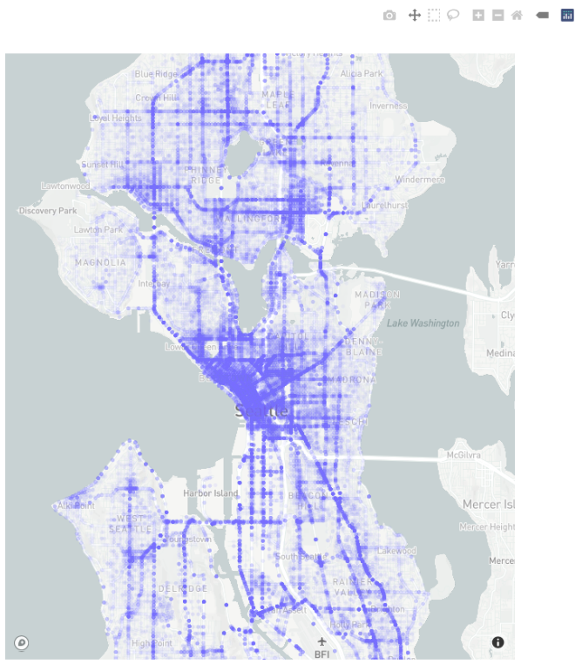
The busiest roads have reported the largest number of accidents
The accident location will be an independent variable to put into the model

Slide 13
Classification
K-Nearest Neighbor (KNN)
KNN will help us predict the severity code of an outcome by finding the most similar to data point within k distance.
Decision Tree
A decision tree model gives us a layout of all possible outcomes so we can fully analyze the concequences of a decision. It context, the decision tree observes all possible outcomes of different weather conditions.
Logistic Regression
Because our dataset only provides us with two severity code outcomes, our model will only predict one of those two classes. This makes our data binary, which is perfect to use with logistic regression.

Slide 14
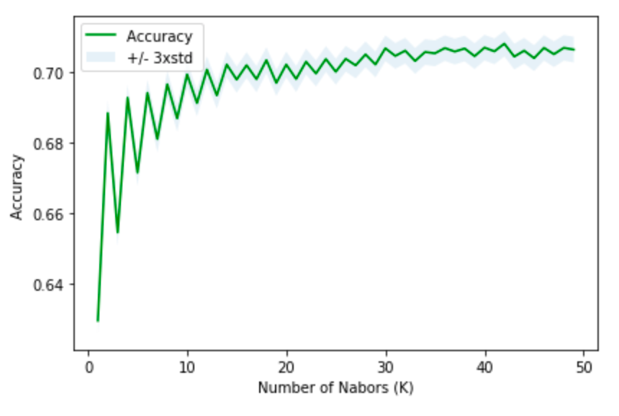
SVM performed best among single algorithms, but the differences were small.
The tuning process choses 42 the best K is hyperparameter, that creates a model with the highest accuracy
The dangers of high K is that too many dimensions made the distance calculation very complicated and data points become 'further' away from each other (thus not effective neighbours)

Slide 15
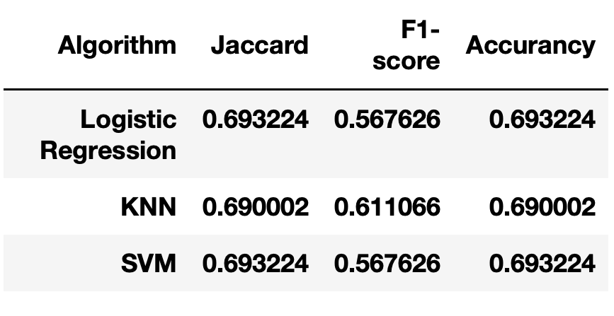
Logistic Regression and Support Vector Machines(SVM) performed best among single algorithms, but the differences with K-Nearest Neighbour(KNN) were small.

Slide 16
Conclusion and future directions
Accuracy of the models has room for improvement.
Record further weather data.
Register all the types of severity
Capture more of traits. Ideas include:
  ○ Physical data (speed, model of vehicle, etc.)
  ○ Driver data (age, driver-points, etc.)

Slide 17
Thanks for your attention!

